Slide 1

Java Programming Essentials: A Comprehensive Journey into Core Java and Beyond
Bharath Ashok

Slide 2

Day 8

Slide 3
Day 8: Agenda
Java Packages
JVM Architecture
Java Memory Model
Garbage Collectors
Interview Questions
Hands-on
Assignments

Slide 4
Java Packages

Slide 5
Java Packages
What is a Package?
A package in Java is a way to organize related classes, interfaces, and sub-packages into a structured hierarchy.
It provides a mechanism to group logically related classes together, making it easier to manage and maintain a large codebase.
Packages help in preventing naming conflicts, provide access control, and contribute to code modularity.

Slide 6
Java Packages
Benefits of Using Packages in Java:
Modularity and Organization: Packages help in organizing classes into meaningful groups, allowing developers to focus on specific functionality.
Naming Conventions: Packages ensure unique naming, reducing the chance of naming conflicts between classes.
Access Control: By default, classes in the same package have package-level access, and this helps in encapsulating the implementation details.
Code Reusability: You can create reusable components in packages, making it easier to share code across different projects.
Collaboration: Packages facilitate separation of concerns.
Maintenance: Organized code in packages is easier to maintain, refactor, and debug.
Dependency Management: Packages allow you to manage dependencies efficiently by clearly indicating the relationships between components.

Slide 7
Java Packages
Package Declaration
A package declaration is the first line of a Java source file.
It specifies the package to which the class belongs.
Example:
package com.example.myproject;
Creating Packages in Java
To create a package, you structure your codebase into directories that correspond to the package hierarchy.
For instance, if the package is com.example.myproject, your class files should be stored in com/example/myproject directory.
Importing Packages and Classes:
You can import packages or specific classes from them using the import statement.
This allows you to use classes without specifying their full qualified names every time.
Accessing Classes in Different Packages:
To access classes from different packages, you use the import statement or specify the fully qualified class name (including the package) when using the class.

Slide 8
Java Packages
Default Package and Its Limitations
Classes without a package declaration belong to the "default package."
It is recommended to avoid using the default package due to limitations in code organization, access control, and potential naming conflicts.
Using Import Statements for External Classes
The import statement helps in using classes without typing their full qualified names.
Example:
import java.util.ArrayList;
Package Naming Conventions:
Package names are typically in lowercase letters to avoid naming conflicts with class names.
The convention often follows a reverse domain name structure, like com.example.myproject.

Slide 9
JVM Architecture

Slide 10
Introduction to JVM and Java Architecture
What is JVM?
Role of JVM in Java Programming
Overview of Java Architecture: Compilation and Execution

Slide 11
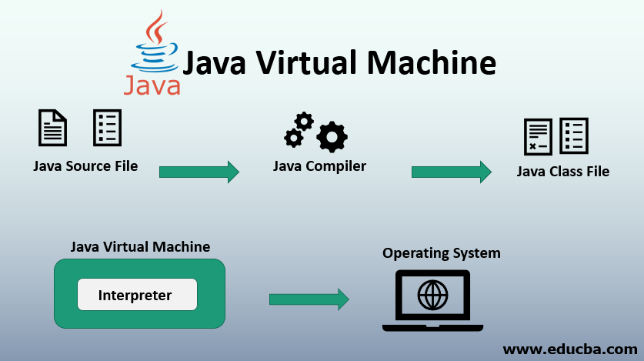
JVM
What is JVM (Java Virtual Machine)?
Java Virtual Machine (JVM) is a fundamental component of the Java Runtime Environment (JRE).
JVM acts as an intermediary between compiled Java code (bytecode) and the host system's hardware and operating system.
JVM is an abstract machine that provides an execution environment and also executes the Java bytecode.
JVM enables Java programs to run on various hardware and operating systems without modification.

Slide 12
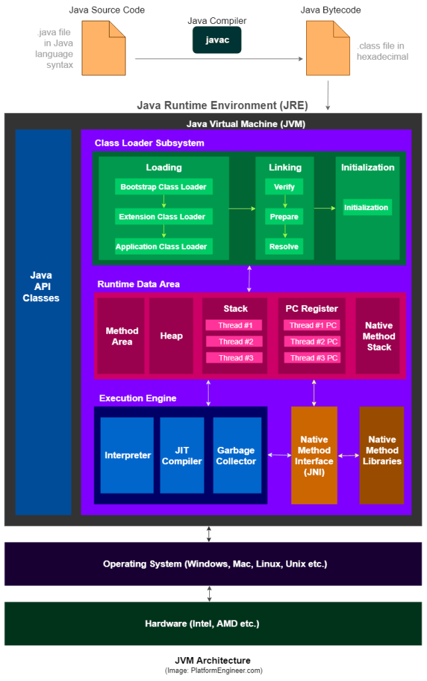
JVM Architecture

Slide 13
Role of JVM in Java Programming
The JVM plays a crucial role in the execution of Java programs:
Loading: JVM loads compiled Java bytecode (.class files) from the classpath into memory.
Verification: It ensures that the bytecode is valid and adheres to security constraints.
Execution: JVM interprets or compiles the bytecode into native machine code that can be executed by the host system.
Memory Management: It manages memory allocation and garbage collection, freeing up memory occupied by objects no longer in use.
Execution Engine: JVM contains an execution engine that runs the bytecode, translating it to machine code.
Platform Independence: JVM abstracts the hardware and operating system details, making Java programs platform-independent.
Security: JVM enforces security checks to prevent unauthorized access to system resources.

Slide 14
JVM Components
Class Loader Subsystem
Runtime Data Area:
Heap, Stack, Method Area, PC Register, Native Method Stack
JVM Instructions and Execution Engine
Bytecode and Just-In-Time (JIT) Compiler
How JVM executes Java programs

Slide 15
JVM Memory Model

Slide 16
Overview of Java Architecture: Compilation and Execution
Compilation
The Java source code (.java files) is compiled by the Java Compiler (javac) into bytecode (.class files). This bytecode is a platform-independent representation of the source code.
Execution
When a Java program is executed, the JVM loads the bytecode into memory and executes it. There are two approaches to execution:
Interpretation
In this approach, the bytecode is interpreted line by line, executing the corresponding machine code for each bytecode instruction. This approach provides platform independence but can be slower.
Just-In-Time (JIT) Compilation
Some modern JVMs use JIT compilation. They convert bytecode into native machine code just before execution, optimizing performance by leveraging the host system's hardware. This approach balances platform independence with improved execution speed.
In Summary:
The Interpreter reads bytecode step by step, and the JIT Compiler turns frequently used bytecode into fast machine code.
Together, these make sure your Java code gets executed by the computer's hardware in an efficient and accurate way.

Slide 17
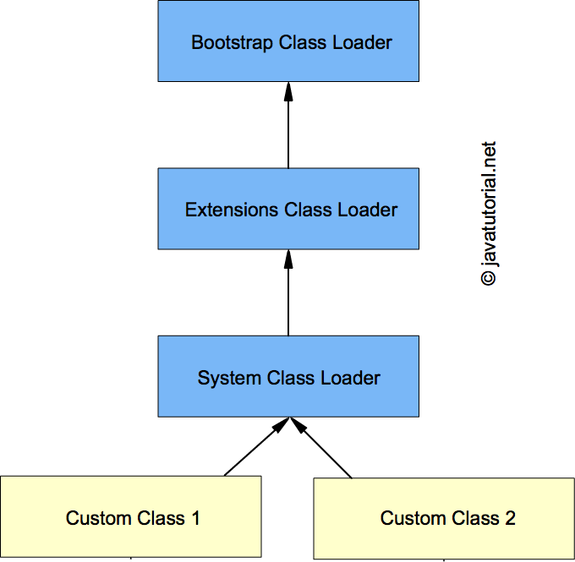






Class Loader Subsystem
The Class Loader subsystem is responsible for loading classes into memory as they are referenced by the program.
It includes three main components:
Bootstrap Class Loader: Loads core Java classes located in the rt.jar file.
Extension Class Loader: Loads classes from the extension directories.
Application Class Loader: Loads classes from the classpath, including user-defined classes.

Slide 18
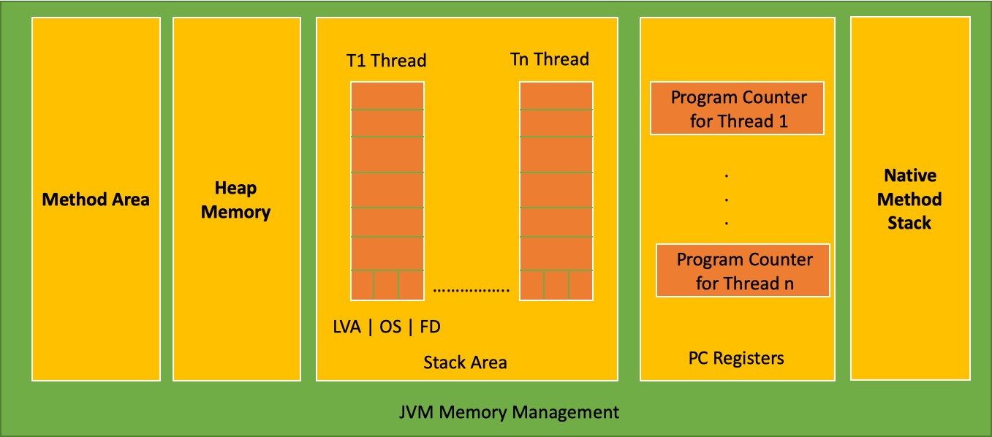
Runtime Data Area: Heap, Stack, Method Area
Heap
The heap is like a big storage area where objects are kept during the program's runtime.
It's where dynamically created objects (like instances of classes) are stored.
The heap is divided into two main parts: Young Generation and Old Generation.
In the Young Generation, there are areas called Eden and Survivor spaces where new objects are created.
Objects that survive multiple rounds of garbage collection in the Young Generation are moved to the Old Generation.
Stack
Imagine a stack of plates. The stack in programming is similar – it keeps track of what a program is doing.
Each time a method is called, a new "plate" is added to the stack (method call frame).
Local variables and function call information are kept on these plates.
When a method finishes, its plate is removed from the stack.

Slide 19
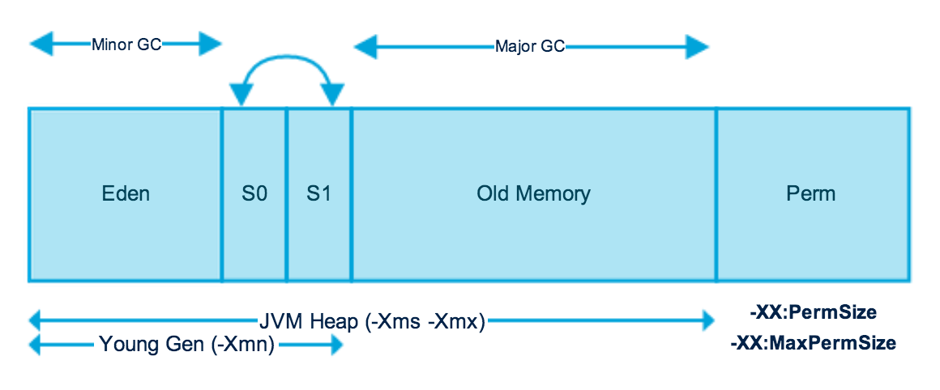
JVM Memory Model
Young Generation
Old Generation
Minor GC
Major GC
Perm Generation

Slide 20
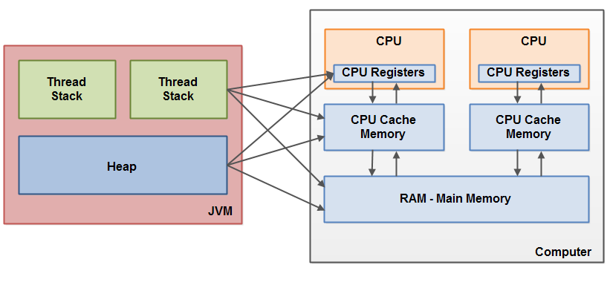
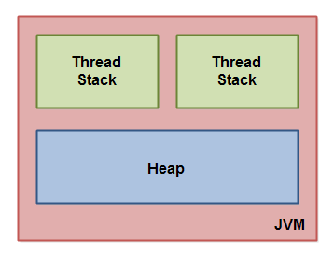
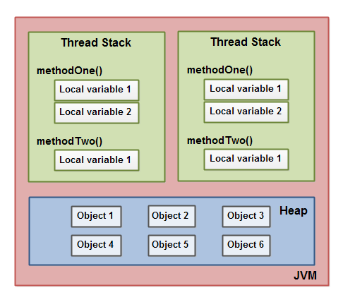
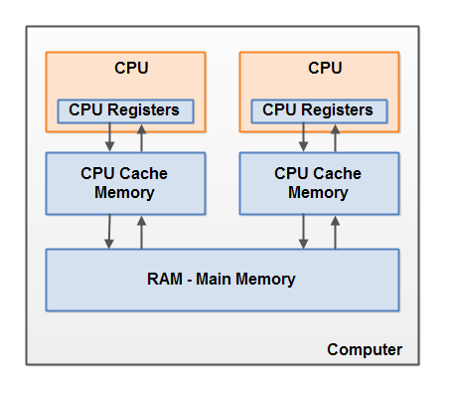
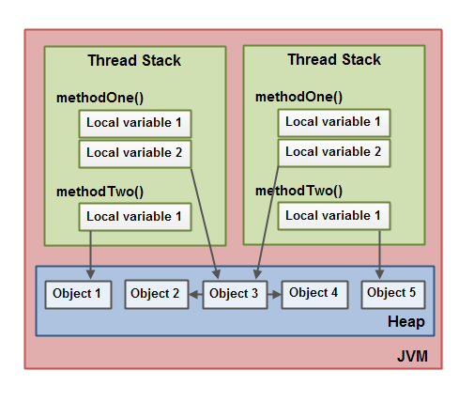
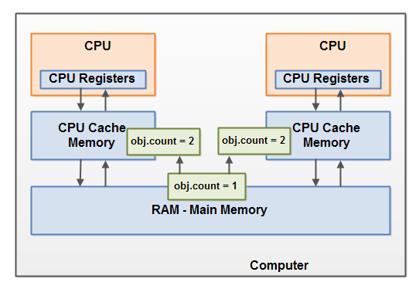
JVM Memory Model
The Internal Java Memory Model
Hardware Memory Architecture

Slide 21
Runtime Data Area: PC Register, Native Method Stack
Method Area
Think of this as a library where the JVM stores information about classes and methods.
It stores class-level data, like method code (instructions), field information, and a constant pool (special values used by methods).
This area is shared among all threads in the program.
PC Register (Program Counter Register)
Imagine you're reading a book and want to remember the page you're on – that's the PC Register.
It keeps track of which instruction the CPU should execute next.
Each thread has its own PC Register.
Native Method Stack
This is like a special area for methods written in other programming languages (not Java).
It's used when Java code calls a method written in a different language.
The data related to these non-Java methods is stored here.

Slide 22
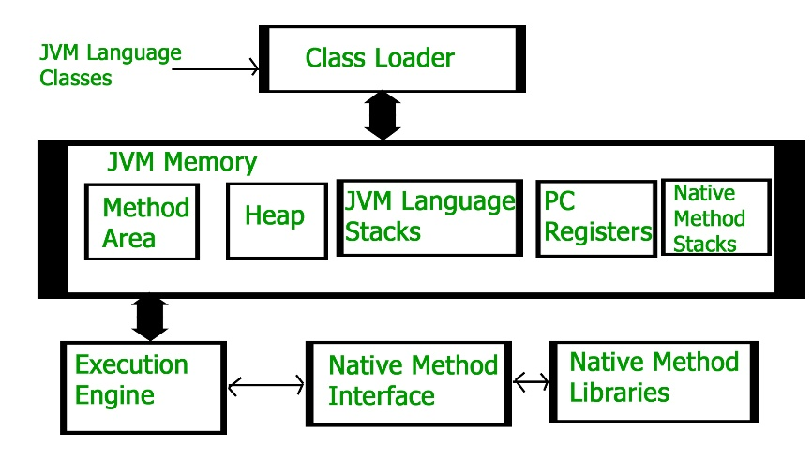
How JVM executes Java programs
Class Loading
The JVM starts by loading the classes that your program uses. These classes are found in the classpath.
The Class Loader subsystem finds and loads the class files into memory. It verifies them to make sure they're safe to use.
Memory Allocation (Heap)
The JVM uses a part of memory called the Heap to store objects created by your program.
When you create objects using new, the JVM sets aside memory for them in the Heap.
The Heap is divided into two parts: Young Generation and Old Generation.
Method Execution
When you call a method in your program, the JVM creates a special area in memory called the stack frame.
The stack frame holds all the information about the method call, like local variables and method parameters.
Each method call gets its own stack frame, like a stack of plates, where each plate holds the information for one method.

Slide 23
How JVM Executes Java Programs
Memory Allocation (Heap)
The JVM uses a part of memory called the Heap to store objects created by your program.
When you create objects using new, the JVM sets aside memory for them in the Heap.
Method Execution
When you call a method in your program, the JVM creates a special area in memory called the stack frame.
The stack frame holds all the information about the method call, like local variables and method parameters.
Execution Engine
The Execution Engine takes the bytecode (special instructions) generated by the Java Compiler and executes them.
It can do this in two ways:
It can read each bytecode instruction one by one and do what it says (this is called interpreting).
It can turn groups of bytecode instructions into super-fast machine code (using the JIT Compiler), which is then executed directly by the computer's hardware.

Slide 24
Java Memory Management

Slide 25
Java Memory Management
Overview of Java Memory Management
Stack vs. Heap Memory
Java Objects and Memory Allocation
Object Creation and Initialization in Heap
Reference Variables and Object Lifetimes

Slide 26
Overview of Java Memory Management
Java memory management involves allocating and managing memory resources for objects and data used by Java programs.
The Java Virtual Machine (JVM) handles memory management, ensuring that memory is efficiently used and objects are properly allocated and reclaimed.
Stack vs. Heap Memory
Stack Memory:
It's like a stack of plates, where each plate represents a method call.
Local variables, method parameters, and method call information are stored here.
The memory is automatically managed, and when a method call finishes, its plate is removed.
Heap Memory:
It's a large storage area where objects are stored.
Objects created using the new keyword are allocated memory here.
The memory needs to be manually managed, and the Java Garbage Collector helps remove objects that are no longer used.

Slide 27
Java Objects and Memory Allocation
Java objects are instances of classes. They have data (fields) and methods associated with them.
Memory is allocated for objects in the heap when they are created using the new keyword.
Object Creation and Initialization in Heap:
When an object is created using new, the JVM allocates memory for the object in the heap.
The memory is used to store the object's data (fields) and a reference to the object's class.
Reference Variables and Object Lifetimes:
A reference variable is like a pointer that points to an object in memory.
Objects exist in the heap until they are no longer reachable.
An object becomes unreachable when there are no reference variables pointing to it. When an object becomes unreachable, the Garbage Collector will eventually reclaim its memory.

Slide 28
Garbage Collection

Slide 29
Garbage Collection Basics
Introduction to Garbage Collection
Purpose and Benefits of Garbage Collection
How Garbage Collection Works
Mark-and-Sweep Algorithm and other Garbage Collection Algorithms
Generational Garbage Collection (Young and Old Generation)

Slide 30
Introduction to Garbage Collection
Garbage Collection is an integral part of the Java Virtual Machine (JVM) responsible for handling memory automatically.
Its primary purpose is to prevent memory leaks and improve memory utilization by reclaiming memory occupied by objects that are no longer needed or accessible.
By automating memory management, Garbage Collection reduces the burden on developers to manually release memory resources.
Purpose and Benefits of Garbage Collection:
Prevent Memory Leaks: Garbage Collection ensures that memory used by unreachable objects is released, preventing memory leaks and allowing resources to be properly managed.
Automatic Memory Management: Developers don't need to manually free memory, reducing programming complexity and human errors.
Enhance Productivity: Focus shifts from memory management to application logic, increasing developer productivity.
Optimized Memory Usage: Garbage Collection optimizes memory usage by removing unused objects, making efficient use of available memory.

Slide 31
How Garbage Collection Works
Identifying Unreachable Objects: The Garbage Collector identifies objects that are no longer reachable from any reference variable in the program.
Mark-and-Sweep Algorithm:
This algorithm involves two phases: marking and sweeping.
During marking, the Garbage Collector traverses through all reachable objects, marking them as "alive."
In the sweeping phase, the collector scans the memory and reclaims memory occupied by unmarked (dead) objects.
Generational Garbage Collection (Young and Old Generation):
This approach divides objects into different generations based on their age and usage patterns.
The heap is typically divided into two main parts: Young Generation (where new objects are created) and Old Generation (where long-lived objects reside).

Slide 32
Generational Garbage Collection
Young Generation:
New objects are created in the Young Generation.
A portion of the Young Generation is used as an Eden space.
Objects that survive a garbage collection in the Young Generation are moved to Survivor spaces (usually two).
After several rounds of survival, objects are promoted to the Old Generation.
Old Generation:
The Old Generation contains long-lived objects that survived multiple collections in the Young Generation.
Since objects in the Old Generation are less likely to become unreachable, garbage collection in this generation is less frequent.

Slide 33
Garbage Collection Algorithms
Serial GC: mark-sweep-compact
Parallel GC: N threads for young generation
Parallel Old GC: Equals threads for both young and old generation
Concurrent Mark-Sweep (CMS) Algorithm
Concurrent marking and sweeping to reduce pause times.
Identifies live objects while allowing application execution.
Complex due to concurrent nature.
G1 (Garbage First) Algorithm
Divides heap into regions, collects with minimized pause times.
Adapts collection strategy based on heap state.
Balances pause times and memory utilization.

Slide 34
Interview Questions

Slide 35
Package Interview Questions
What is a package in Java and what purpose does it serve?
How do packages help in organizing classes in Java?
What is the purpose of a package declaration at the beginning of a Java source file?
How are naming conflicts avoided using packages in Java? How can you create a package in Java?
What is the default package in Java, and why is it discouraged to use?
How can you access a class from a different package in Java?
What is the difference between importing a specific class and importing an entire package?
How does the concept of packages contribute to encapsulation and access control in Java?
What is the role of access modifiers (public, protected, private, default) in packages?

Slide 36
Package Interview Questions
What is a fully qualified class name, and when is it used?
Can classes in the same package have package-private access to each other's members?
What is the purpose of the import statement in Java?
How does the JVM locate classes within packages during compilation and execution?
Explain the concept of hierarchical organization of packages in Java.
How can you organize sub-packages within a larger package? What is the difference between the classpath and the package name in Java?
Can multiple classes have the same name if they belong to different packages?
What are some best practices for naming packages and classes in Java?

Slide 37
JVM Architecture Interview Questions
What is the Java Virtual Machine (JVM), and what role does it play in Java programming?
Explain the concept of "Write Once, Run Anywhere" in the context of JVM.
What are the main components of the JVM architecture?
Describe the process of compiling and executing a Java program using the JVM.
What is the purpose of the Class Loader subsystem in the JVM?
Explain the roles of the Bootstrap Class Loader, Extension Class Loader, and Application Class Loader.
How does the JVM handle memory management during program execution? What are the memory areas in the JVM?
What is the purpose of the Method Area (Permanent Generation) in the JVM's memory structure?
Describe the function of the Java Stack and its relation to method calls in the JVM.
What is the Native Method Stack, and how does it differ from the Java Stack?
How does the JVM manage the execution of Java bytecode? What are the roles of the Interpreter and JIT Compiler?

Slide 38
JVM Architecture Interview Questions
What is the significance of the PC Register (Program Counter) in the JVM?
How does the JVM handle exceptions during program execution?
What is the purpose of the Classpath in the JVM's execution environment?
Explain the significance of the "java" command when launching a Java program.
How does the JVM handle multithreading and synchronization?
Describe the significance of the "native" keyword in Java and how the JVM interacts with native methods.
What is the role of the Security Manager in the JVM's security architecture?
How does Just-In-Time (JIT) compilation improve the performance of Java programs?
Explain the concept of "HotSpot" in the context of JVM optimization.
Describe the JVM's ability to dynamically load and link classes during program execution.
How does the JVM ensure platform independence while executing Java programs?

Slide 39
Garbage Collection Interview Questions
What is garbage collection in Java, and why is it important?
How does garbage collection contribute to memory management in Java?
Describe the process of identifying and reclaiming memory occupied by unreachable objects.
What is the difference between the Young Generation and the Old Generation in garbage collection?
Explain the concept of Generational Garbage Collection and how it works.
How does the Mark-and-Sweep algorithm work for garbage collection?
What is memory fragmentation, and how do garbage collection algorithms address it?
How does the Copying Algorithm optimize memory usage in the Young Generation?
What is the purpose of the Mark-Compact algorithm in garbage collection?
Explain the advantages of using the Concurrent Mark-Sweep (CMS) algorithm.

Slide 40
Garbage Collection Interview Questions
How does the G1 (Garbage First) garbage collection algorithm optimize memory management?
How does garbage collection interact with objects that have different lifetimes?
What are the trade-offs between pause times and efficiency in garbage collection algorithms?
What are the challenges of managing memory in long-lived objects during garbage collection?
Explain how garbage collection contributes to the "Stop-the-World" phenomenon and its implications.
What strategies can developers employ to optimize memory usage and minimize the impact of garbage collection?
How does understanding the principles of garbage collection impact the design of Java applications?
Describe scenarios where using specific garbage collection algorithms would be advantageous.
What are some common memory-related issues that developers might encounter in Java applications?
How can monitoring and tuning garbage collection settings improve application performance?

Slide 41
Assignments

Slide 42
Assignments
Assignment 1: Creating Packages and Importing Classes
Create a package named "com.myapp.util".
Inside the package, create a class named "MathUtils" with methods to calculate addition, subtraction, multiplication, and division.
In a separate class, import and use the "MathUtils" class to perform mathematical operations.
Assignment 2: Organizing Code Using Packages
Create a package structure for a simple address book application.
Inside the package, create classes for "Person" and "Address" with relevant attributes and methods.
Use these classes in a main class to simulate adding and searching for people in the address book.
Assignment 5: Package Naming Conventions and Best Practices
Choose a domain name in reverse order, like "com.example.myapp".
Create a package structure for a small e-commerce application with categories such as "product", "order", and "user".
Inside each package, create relevant classes following naming conventions.

Slide 43
Q&A

